Slide 1



5th Grade
Parent Information
2024-2025
Notes:
Dr. Daniel

Slide 2

House of Champions
“Be Your Baggett Best”
We CAN and We Will…Together Everyone Achieves More
We are promoting school wide expectations within a safe and effective learning environment.

Slide 3
Meet the 5th Grade
Team!
Mrs. Auxford
Mrs. Owens
Mrs. Rollins
Ms. Vaughan

Slide 4

Parent Communication
Every Wednesday, take home folder ~ graded papers and school communication
(expect to see our take home folder!)
Newsletter & Behavior Sheet
Blackboard ~ automated phone call
Talking Points
Marquis

Slide 5
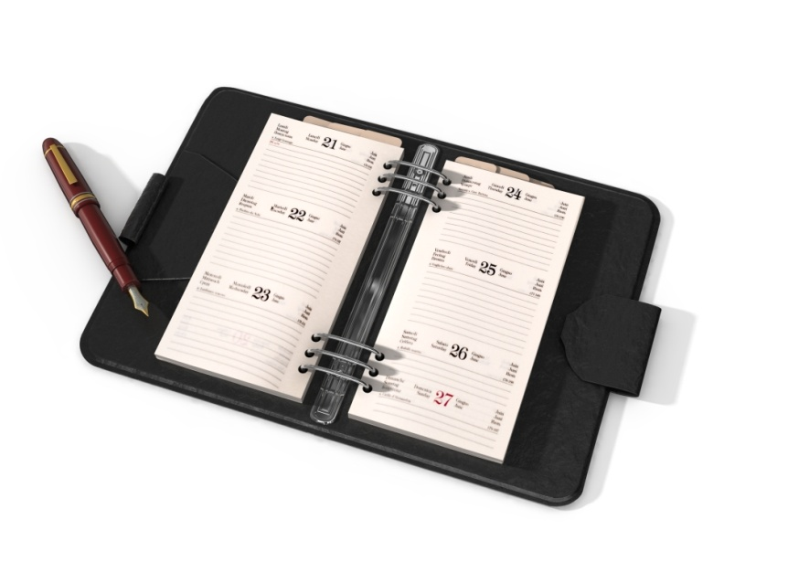
Behavior Sheet
Is our “daily communication” method for our students
Please sign the behavior sheet nightly
If there are any transportation changes and excuses, please send in on a separate sheet of paper

Slide 6

Celebrate Students
Student of the Week ~ all classes
(based on Character Education Themes)
Birthdays & Class Treats
  If you are sending in treats for your child to share, they must be store purchased with ingredients labeled

Slide 7
Parental Involvement
Parent Resource Center
  Media Center Hours: 7:30-3:00 (follow directions for check out procedures)
    If you need more information about the Parent Resource Center contact LGray@paulding.k12.ga.us
    Family Nights – More Information Coming Soon!

Slide 8

School Fundraisers & PTA
Fall Fundraiser
Book Fair ~ Fall & Spring
They will be during the Parent/Teacher conferences week in October and March…both F2F book fair for students and an online book fair for parents and virtual students hosted at the same time. There will also be a BOGO F2F book fair in May.
Thursday Ice Cream Sales – REVTRAK only
Hat Day – 50 cents every Friday
PTA Hosts many events throughout the school year – including our beginning of the year Ice Cream Social, Fall Festival, and Dances

Slide 9


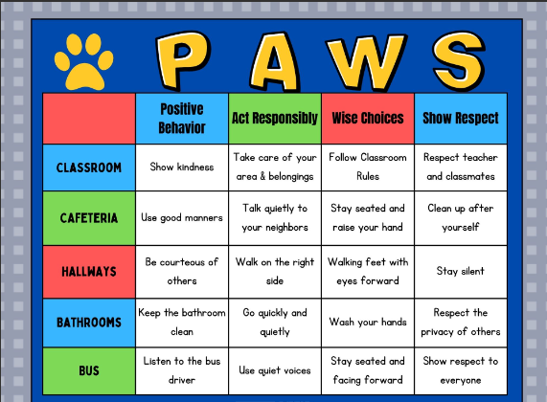
Discipline & Expectations

Slide 10

What are “Fish” for?
When school employees “catch” a student demonstrating these expectations they may be awarded a fish.
These fish will go into the school pond mural
From these fish, Mrs. Hodge will draw names for a special treats
“P with the Principal”
“ Popsicles with the Principal” and more!

Slide 11

5th Grade Expectations
We expect our students to follow school expectations
Have a positive mindset
Being prepared for class
Working on their study habits

Slide 12
5th Grade Expectations
Working on Canvas and completing assignments in a timely manner.
Doing their personal best
Taking all materials home nightly.

Slide 13

End of Year Goals
Reading Fluency: 130 wcpm
Lexile Range: 830 - 1010
Mastery of at least 3/5 standards in reading
Mastery of at least 5/8 standards in math
Mastery of 6/9 ELA standards
Mastery of 7/10 Social Studies standards
Mastery of 5/8 Science standards

Slide 14


Slide 15
Lunch Prices
Currently – Lunch: $2.15
Please fill out the free and reduced lunch form for funding purposes

Slide 16


DARE and 4-H
Deputy Davis is our D.A.R.E. officer.
Mrs. Josie is our 4-H director at Baggett. She encourages our students to work on public speaking, volunteer work, and incorporates Science.

Slide 17
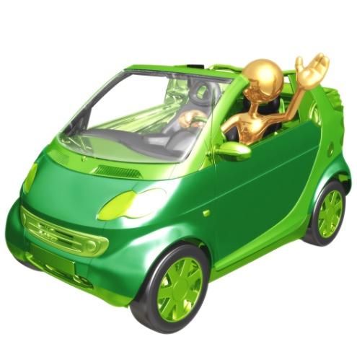
Car Rider & Dismissal
Please remain in your car during car rider for safety and effectiveness
Transportation Changes must be in writing with your signature and date – We cannot accept changes via email, text, or through TalkingPoints
Single car rider will be dismissed from the front of the building.
Family car rider is dismissed
by the gym.

Slide 18
Parent Excuses/Tardies
We know that children get sick. If your child misses a day of school, please send in either or parent note or doctor's note to excuse their absence on the day they return to school.
You are allowed three parent notes per semester, and we are required to contact you on the third unexcused absence.
Students are considered tardy if they are not in the classroom by 8:00am.

Slide 19
Preparing for Middle School
We have been told over the years that Baggett’s students are always ready for Middle School.
We are working with your child on responsibility, accountability, and organization to help prepare in their transition.

Slide 20
Parent Portal
This year, many of our progress reports and report cards will not be printed. Please make sure you have a parent portal account.
Instructions for Activating a Parent Portal Account
Please send an email to portal@paulding.k12.ga.us and the following information. A copy of parent picture id must also be included in the email.
Parent Name
Parent Physical Address
Parent Email Address
Student First Name
Student Last Name
Student’s Date of Birth
Student(s) Physical Address
Name of School Student Attends

Slide 21
A Year To Remember
We are excited to work with your child and your family this year.
Our school will be utilizing Canvas a great deal in our classes and at home.
Please contact us if you have any questions at all through Talking Points or email.
Looking forward to a fantastic year!

